Slide 1
UNC Charlotte Analytics
Group 10
ITCS 4155 Y05 - Sprint 2 Deliverable

Slide 2
Project Roles
Group 10
Kevin Kim
Richard Scott
Manu Kakani
Chase Blackwelder
Brandon Burgess
Advisors
Rick Hudson, Sr. Project Manager
Dr. Jim Rudd, CCI Professor
Notes:
Group Number/Group Name/Names of team members and the roles

Slide 3
Summary
This project’s primary focus is to identify the crowdedness of specific areas around campus, and to present the data through diverse visualizations that display the desired information.
This is done by using data about devices connected to different Wi-Fi access points around campus.
This data can be visualized in ways that university could use to determine if some buildings are overcrowded, or underutilized.
Other possible benefits are analysis of foot traffic, reactions to emergency situations, or use by law enforcement to locate people.
Notes:
Summary of the project/epic (What will be the end result of our project?)

Slide 4
Platform
Our application prototype is currently running on Jupyter Notebook.
Jupyter Notebook is an open-source web application that we are using for development and debugging purposes.
Our final product will be a web application that can be used on either desktop or mobile devices.
Notes:
Specify the platform the prototype is running on (iOS, web, Android)
Web application

Slide 5





Tools
Anaconda
Jupyter Notebook
Python
Pandas
Plotly
Notes:
Specify which tools you used in building Sprint 2
Python, Jupyter Notebook, Plotly, Dash, Pandas

Slide 6
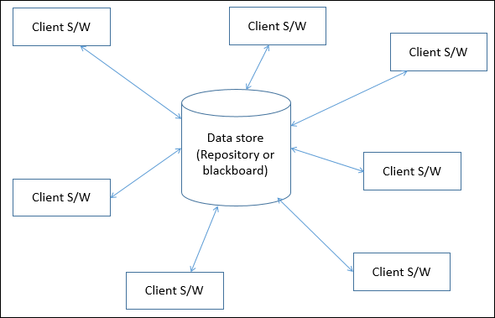
Architecture
Data-Centric
This application is built entirely around the data.
The service provided relies on the pulling and processing of information contained in the collected data.
Why data-centric?
Gives us a way to organize and interpret the data we are acquiring/working with in an agile way.
Notes:
Chosen architecture and why?
Data-Centric?
Data-Centric: https://tdan.com/the-data-centric-revolution-data-centric-vs-data-driven/20288#:~:text=Data%20centric%20refers%20to%20an,and%20applications%20come%20and%20go.&text=Businesses%20want%20functionality%2C%20and%20they,tied%20with%20this%20data%20model.

Slide 7
User Stories Illustrated in Application Demo
As a UNC Charlotte Faculty member, I should be able to access the website by logging in quickly and easily, so I can access the desired data as soon as possible (Story 1).
I can successfully login and access the website in a timely manner.
As a UNC Charlotte Faculty member, I should be able to view occupancy data from previous archived days so I can compare it to the present data (Story 7).
I can view data from previous days by choosing the date from a dropdown.
As a UNC Charlotte Faculty member, I should be able view changes in population during the course of the day so I can formulate better plans for emergency situations (Story 6).
I can see changes in occupancy in buildings as the day progresses through visualizations, such as a line graph.
Link to User Story Document
Notes:
A description of the user story or stories being illustrated in the application
Potential User Stories to Demonstrate in Application -
User Stories here: https://docs.google.com/spreadsheets/d/1UiN2TU4cDGE-fRFOiDzHT2Z_KyqQbHzyPcUygXpcSjY/edit#gid=0
Story 1:
As a UNC Charlotte Faculty member, I should be able to access the website by logging in quickly and easily, so I can access the desired data as soon as possible.
Card Back:
I can successfully login and access the website in a timely manner.
Story 4:
As a UNC Charlotte Faculty member, I should be able attain the current population of the campus so I can know how many individuals are currently on campus.
Card Back:
I can view total active population count.
Story 6:
As a UNC Charlotte Faculty member, I should be able view changes in population during the course of the day so I can formulate better plans for emergency situations.
Card Back:
I can see changes in occupancy in buildings as the day progresses through visualizations, such as a line graph.
Story 7:
As a UNC Charlotte Faculty member, I should be able to view occupancy data from previous archived days so I can compare it to the present data.
Card Back:
I can view data from previous days by choosing the date from a dropdown.
Story 12:
As a UNCC student, I would like to see how crowded each gym is before visiting so I can know if there will be enough equipment free.
Card Back:
I can check the occupancy of each gym to determine which one would give me the most use of equipment.

Slide 8
Application Demo
Notes:
Interactive demo of the application (talk through it using info from the previous slides if possible)

Slide 9
Design Decisions Based on Feedback
Used more tools in the production process of the prototype.
Original prototype consisted of only HTML and CSS.
Added more diverse types of visualizations.
i.e. pie charts, line graphs, planning on adding heatmaps, etc.
Separated/categorized some of the graphs to allow for a better viewing experience.
Implemented features like a dropdown selection, which allows the user to view data from previous days on its own page.
Notes:
Design decisions made on basis of changes in user stories, student feedback, professor and TA feedback

Slide 10
Estimated vs Actuals for Sprint 2
User Story | Estimated Size | Actual Hours
Story 1 (Login functionality) | S | 1
Story 3 (Graphically view building occupancy) | M | 3
Story 4 (View total population count) | S | 3
Story 5 (Accessibility of application) | M | 5
Story 6 (Line graph visualization as day progresses) | L | 3
Story 7 (Dropdown functionality) | S | 2
Story 15 (Application loads fast - Data Engineering) | L | 10
S | 3 Hours
M | 5 Hours
L | 9 Hours
Link to User Story Document
Notes:
For each story: Story Size (SML) and estimated hours per size and then the actual hours.

Slide 11
Lessons Learned
Everyone is different in terms of their ability to learn how to use a new IDE and language; it is important to consider how fast or slow they will be able to get the work done.
Communication is important.
There should be constant communication about whatever is being done/worked on to see if there is duplicate work being done, or to check up on the progress of the project.
Having a set time for a weekly meetup to discuss the project and keep up with others’ progress is crucial to staying on track.
Notes:
Lessons learned

Slide 12
Thank you!

